Slide 1
IMPLEMENTATION OF NEW SHELL AND ITS FUNCTIONS
CSE2005: OPERATING SYSTEMS
Presented By:
AVULA ROHITHA -17BLC1007
KONENI MADHU SWAPNIKA -17BLC1024
AARTHI G -17BLC1166

Slide 2
ABSTRACT
The main purpose of this project is to create our own shell and include our own functions in it for the ease of access and reducing the burden of memorizing difficult keywords and a bunch of long commands. We have used C language to code our program. The main functions that we have implemented are listed below:
→cddir →rname
→help →cwd
→exit →list
→makedir →hist
→sysdate →virstat
→deldir →calender
→dskmem →interr

Slide 3
FUNCTION DESCRIPTION
→cddir - changes the present working directory
→rname - renames the file
→hist- returns command history
→sysdate- displays current system data and time
→virstat- virtual memory statistics
→deldir- deletes a particular directory
→calender- displays the calendar of the current month
→dskmem - shows disk space usage
→interr- shows number of interrupts
→help - lists down the use of each function
→cwd- returns current working directory
→exit- exits the shell
→list- returns a list of all directories
→makedir- creates a new directory

Slide 4
MODULES
→Reading the line
We can’t simply allocate a block and hope they don’t exceed it. Instead, we need to start with a block, and if they do exceed it, we have to reallocate with more space. This is a common strategy in C, and we’ll use it to implement lsh_read_line().
→Parsing the line
Now, we need to parse that line into a list of arguments. We’re going to make a glaring simplification here, and say that we won’t allow quoting or backslash escaping in our command line arguments. Instead, we will simply use whitespace to separate arguments from each other. So, the command echo "this message" would not call echo with a single argument "this message", but rather it would call echo with two arguments: "this and message".

Slide 5
MODULES Cont..
→Executing the line
There are only two ways of starting processes on Unix. The first one (which almost doesn’t count) is by being Init. When a Unix computer boots, its kernel is loaded. Once it is loaded and initialized, the kernel starts only one process, which is called Init. This process runs for the entire length of time that the computer is on, and it manages loading up the rest of the processes that we need for our computer to be useful.
→Validating functions
We are building terminal functions as well as customised functions scripted in C code. These functions also include individual help on what they perform and its corresponding syntax.

Slide 6
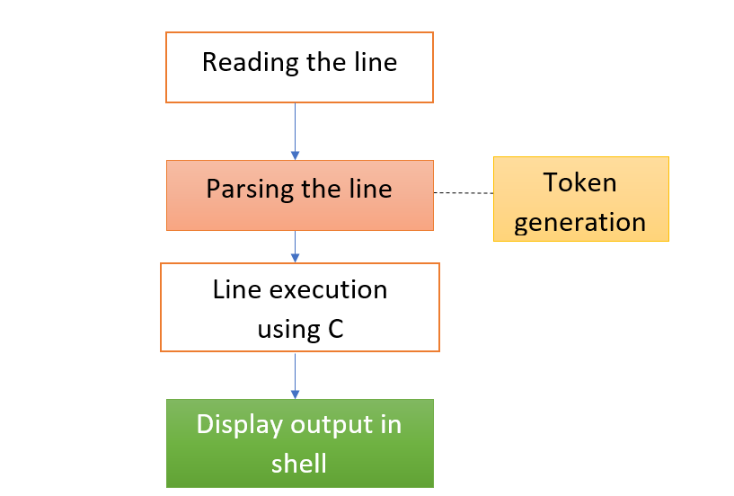
ARCHITECTURE / BLOCK DIAGRAM

Slide 7
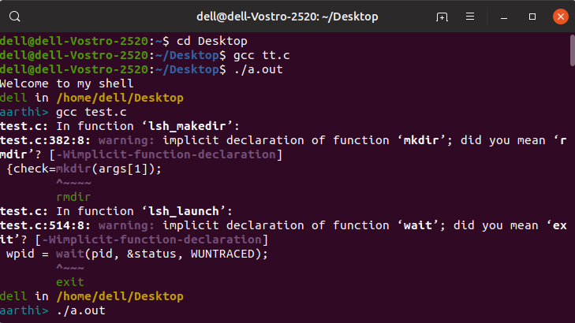
SCREEN SHOTS OF OUTPUT

Slide 8

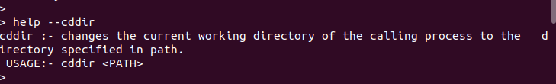
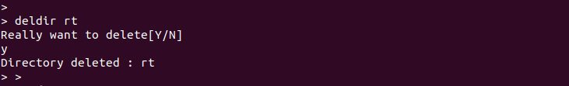

Slide 9


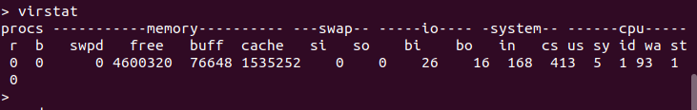

Slide 10
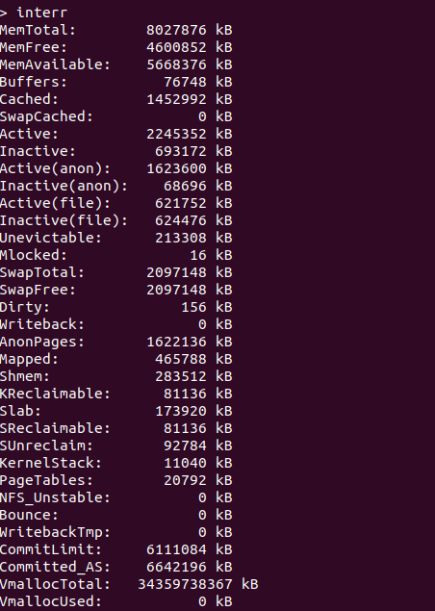
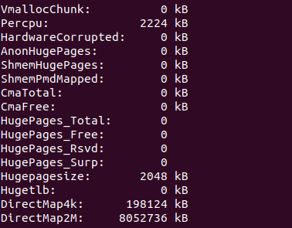

Slide 11
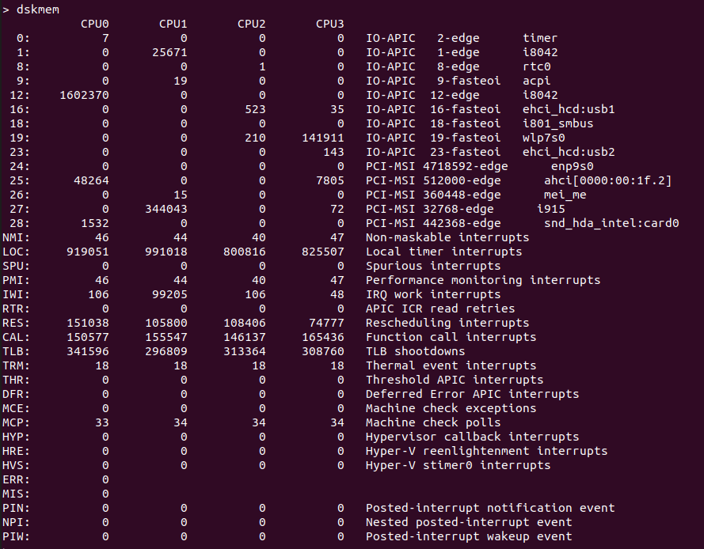

Slide 12
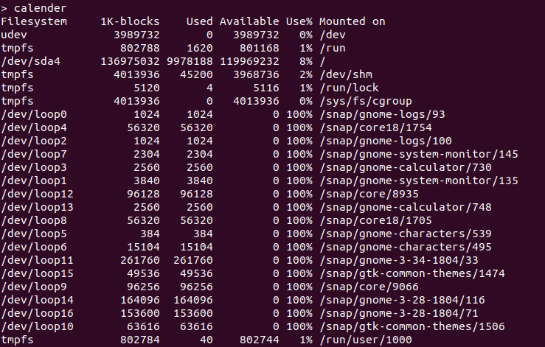

Slide 13



Slide 14
FUTURE WORK
Wider range of functions can be included in the shell
Correction of mis-performing functions could be rectified
Lines of code can be reduced by shifting to better performing languages like python, java, etc.

Slide 15
REFERENCES
https://brennan.io/2015/01/16/write-a-shell-in-c/
http://pubs.opengroup.org/onlinepubs/9699919799/functions/getline.html
http://www.binarytides.com/category/distros/linux-mint/
https://ss64.com/bash/
http://brainstorms.in/pdf/commonds.pdf
A book by O'Reilly, GNU CoreUtils

Slide 16


